Slide 1
FAMILY PLANNING
Dr. Ali F. Al-Assadi
Professor of obst. & Gyne.
Basra Medical College

Slide 2
Definitions:
Contraception: Is the prevention of conception by methods other than abstinence from coitus.
Sterilization: Is a procedure which destroys the procreative function & the effect is permanent.
Assessment of effectiveness:
Pearl index: Is the No. of unwanted pregnancies which occur in 100 women using that method for a year (H.W.Y.)

Slide 3
Classification: (1)
1. Methods do not requiring medical consultation
Male ------ coitus interruptus.
------ condom ( sheath).
Female ---- safe period.
---- vaginal spermicides & tampon.

Slide 4
Classification: (2)
2- Methods requiring medical supervision:
Oral contraceptions---- COC.
---- Variable dose COC.
---- Continuous progest.
Injectable steroids ( Progesterone).
Postcoital methods.
IUCD.
Occlusive diaphragms & caps.

Slide 5
Classification: (3)
3- Permanent methods ( sterilization):
Female ----- Tubal ligation.
Male ----- Vasectomy.

Slide 6
Indications:
Communal:
1- limitation of stocks.
2- Improvement of stocks.
Individual :
Temporal dz in either partner.
Chronic dz eg. Nephritis.
Previous obstet complications eg. PE & repeated CS.
Dz transmissible to the fetus eg. Syphilis.
Birth spacing.
Early & late years of marriage.
On request.

Slide 7
Safe period: (1)
Based on identification of the time when the ova can be fertilized.
Pearl index 20- 30.
1-Calendar methods:
Regular cycle eg. 28days → 28 – 14 = 14 (date of ovulation is 12-16), add 1 to 16 & subtract 3 from 12, The dangerous period is from day 9- day 17.
Irregular cycle → find the shortest & the longest cycle in the past year of the female.
The dangerous period is the shortest cycle – 18 days & the longest cycle – 11 days.

Slide 8
Safe period: (2)
2- Symptothermal method.
3- ovulation method.

Slide 9
Coitus interruptus:
Withdrawal of the penis at the moment before ejaculation.
Pearl index 20-30.
Side effects:
Anxiety.
Insomnia.
Suicide.

Slide 10
Lactational Amenorrhea Method (LAM)
Temporary option for women who are:
  Within 6 months postpartum, and
  amenorrheic, and
  Fully or nearly fully breastfeeding
More than 98% effective

Slide 11
Physiology of Lactational Amenorrhea
(Mechanism of Action)
Reduced GnRH production/
Reduced LH production
Non-fertile State
suckling
altered
amenorrhea
ovarian
function

Slide 12
LAM: Advantages
Universally available
At least 98% effective
Begins immediately postpartum
Health benefits for mother and infant
No commodities / supplies required
Bridge to other contraceptives
Builds on established cultural and religious practices
Improves breastfeeding and weaning patterns

Slide 13
LAM: Disadvantages
Breastfeeding pattern may be difficult to maintain.
No STI or HIV protection.
Duration of method limited.
Only useful for fully or nearly fully breastfeeding women.

Slide 14
Barrier methods:
Pearl index 4-8.
Indications:
Protect against STD.
Medical CI to other methods.
The need for CC is infrequent.
During lactational amenorrhea.
Post vasectomy.

Slide 15
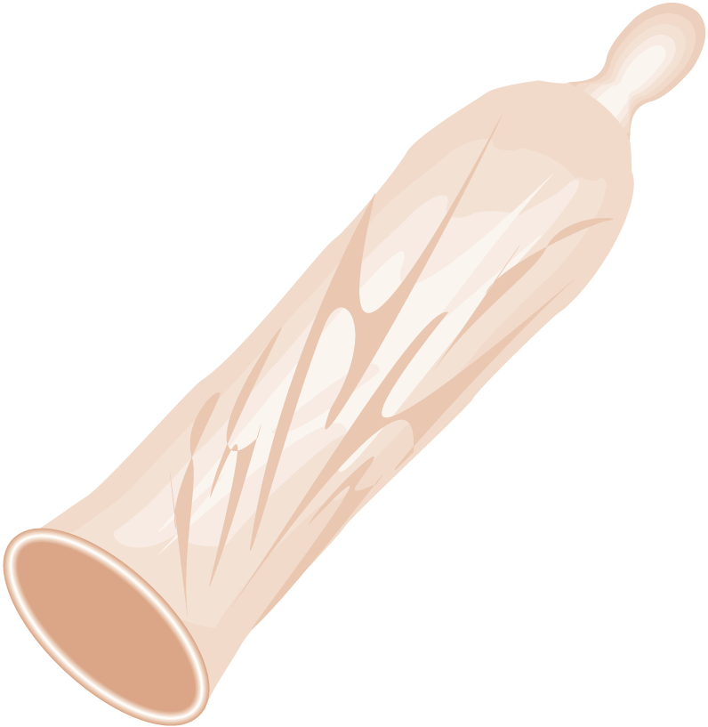
Barrier methods ( male condom):
The oldest.
Latex rubber with spermicides.
Do not require medical supervision.
Protect against STD.
No CI .

Slide 16
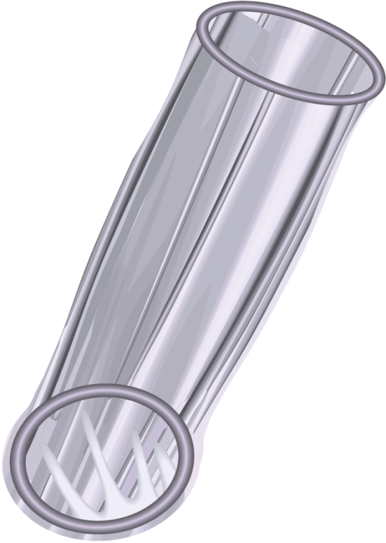
Barrier methods (Female condom):
Femshield.
Loosely fitting sleeve that lines the vagina.
Has 2 rings at both ends.
Protect against STD.
Use during mensis.
More effective than male condom.

Slide 17
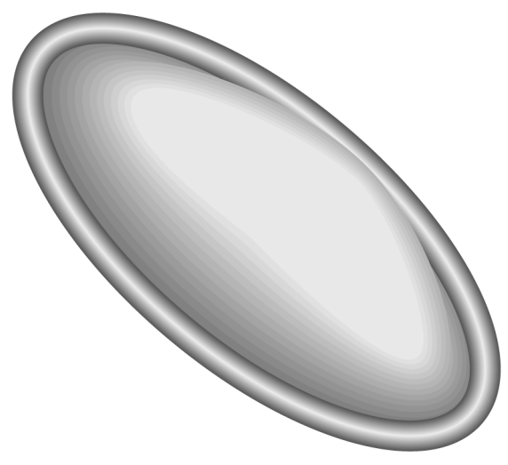
Barrier methods ( Diaphragm) :
Rubber dome with flexible rim.
Should be used with spermicides before each intercourse & removed 6 Hr later.
Side effects:
Allergy
UTI.
Felt by the partner sometimes.

Slide 18
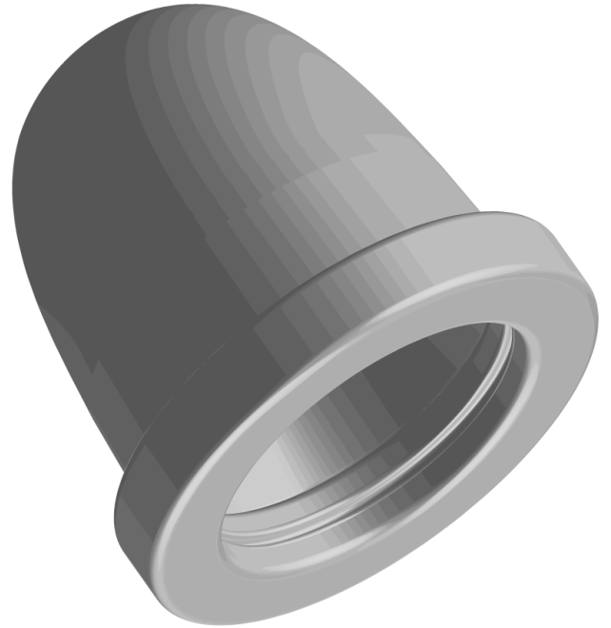
Barrier methods (Cervical Caps):
Bell shaped.
Rubber.
Fit the cervix.

Slide 19
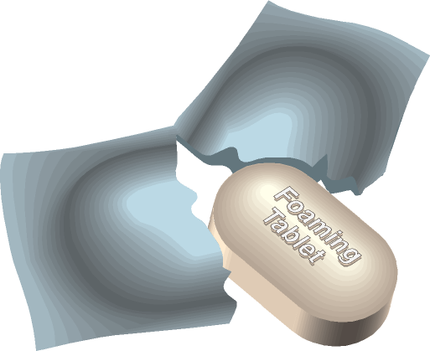
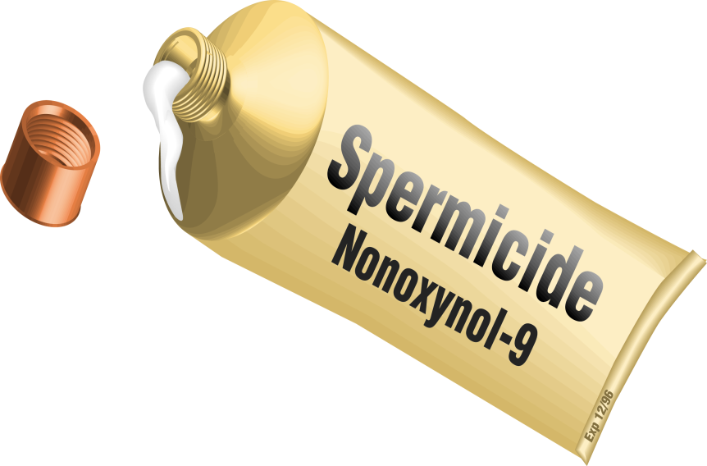
Barrier methods (Spermicides):
Chemicals that kill the sperm.
eg. Nonoxynol -9, Octoxynol- 9.
Best used with other barriers.
Protect against STD including HIV.

Slide 20
Intra-uterine Contraceptive Device (1) (I.U.C.D.)
They are of 3 types.:
1-Inert device eg. Lippes loop.
2-Device with various application of Copper.
3-Medicated IUCD eg. Progestasert or Marina.

Slide 21
Intra-uterine Contraceptive Device (2) Advantages:
Efficacy approximate that of COC.
Lippes loop need not be replaced.
CU-IUCD is more effective than inert & cause less blood loss.
Medicated IUCD reduce menstrual blood loss & used also to treat menorrhagia & endometrial hyperplasia.

Slide 22
Intra-uterine Contraceptive Device (3) Mechanism of action
The exact mechanism is not fully understood.
Inhibit sperm migration.
Interferes with ovum transport & fertilization.
Stimulate sterile forging body reaction.
Progesterone containing IUCD → endometrial atrophy & cervical mucous changes which prevent sperm penetration.

Slide 23
Intra-uterine Contraceptive Device (4)
Efficacy & duration of use:
CU-IUCD ( TCU-380A) has failure rate of 0.4-2.5 /HWY. & effective for 10 years.
LNG- IUCD has failure rate of 0.1/ HWY & used for 5 years.
Progestasert is effective for 1 year.

Slide 24
Intra-uterine Contraceptive Device (5)
Indications
On request.
Breast feeding.
Difficulty in obtaining regular contraception supply.
Forgetful female for daily intake.
C.I. to COC.
Female wanting long time reversible contraception.

Slide 25
Intra-uterine Contraceptive Device (6)
Contraindications
Pregnancy.
Acute PID or recent puerperal sepsis.
STD & purulent cervicitis.
Abnormal uterine bleeding of unknown origin.
Confirmed or suspected malignancy.
Congenital anomalies the uterus.
Malignant gestational trophoblastic dz.
LNG- IUCD is CI in beast cancer.

Slide 26
Intra-uterine Contraceptive Device (7)
Timing of insertion & follow up
At time of mensis.
4 weeks postpartum & in lactating female after 6 weeks.
The 1st visit for follow up is within the 1st 3 months then after every year.

Slide 27
Intra-uterine Contraceptive Device (8)
Complications
Immediate
1- Fainting & vasovagal attack.
2- Uterine perforation.
Subsequent complications:
1- Increase menstrual blood loss ( regular or not).
2- Pain either cramping for few days after insertion or dysmenorrhoea.
3- Infection (1st 20 days post-insertion).
4- Ectopic pregnancy.
5- Spontaneous abortion ( increase 3 folds).
6-Preterm labour ( increase by 4 folds).

Slide 28
Hormonal contraceptions
A- Oral contraceptions

Slide 29
Combined oral contraceptives (1)
Contain both estrogen & progesterone in various doses.
Monophasic or multiphasic ( no longer used).
Monophasic ( 21 or 28 days).
Types of hormones:
Estrogen---------→ Ethinylestradiol.
progesterone----→ Levonorgestrel.

Slide 30
Combined oral contraceptives (2) mode of action
Inhibit ovulation by decreasing FSH & LH.
Progesterone cause cx mucous changes.
Production of decidualized endometrial bed with inactive & atrophic glands which become irreceptive to blastocyst.
Failure rate: 0.1/ HWY.

Slide 31
Combined oral contraceptives(3)
Advantages:
Highly effective.
Decrease ectopic pregnancy rate.
Reversible with speedy return of fertility.
Regulate menstrual cycle & decrease menstrual blood loss & relief dysmenorrhoea.
Decrease benign breast dz.
Decrease epithelial ov. Ca.
Decrease endometrial Ca.
Decrease PID.
They are possibly protect against the development of benign ov. Cyst, uterine fibroid, endometriosis & osteoporosis.

Slide 32
Combined oral contraceptives(4)
Side Effects
Minor :
Menstrual disturbances ( breakthrough bleeding & amenorrhoea).
Wt gain.
Mood changes ( depression).
Headache.
Nausea.
facial pigmentation.
Breast discomfort.

Slide 33
Combined oral contraceptives(5)
Side Effects
Major:
Future fertility ( 6/1000 females have amenorrhea for > 12 mon.s)( treated by ovulation induction).
CVS: DVT & PE ( especially with high dose estrogen), HT, IHD & CVA (smokers).
Metabolic changes: aggravate glucose intolerance & hepatic function alteration.
Carcinogenic effect: increase ca cx & weak association with breast ca.

Slide 34
Combined oral contraceptives(6)
Drug interaction
Accelerate biotransformation of barbiturate, sulfonamide, rifampicin & most anticonvulsant.
Antibiotics eg. Amoxycilline & tetracycline cause contraceptive failure.

Slide 35
Combined oral contraceptives(7) contraindications
Absolute:
breast ca.
H/O DVT & PE
active liver dz.
current treatment with rifampicin.
familial hyperlipidemia.
H/O atrerial thrombosis .
pregnancy.
Relative: smoking, age> 35, obesity, HT & breast ca.

Slide 36
Progesterone only pills (mini pills) (1)
Contain 0.3 mg levonorgestrel.
Used continuously with out interruption ( no pill free days).
Failure : 1.5-3/HWY.

Slide 37
Progesterone only pills (mini pills) (2) mechanism of action
Cx mucous changes.
Inhibit ovulation in 50% of female.
Endometrial changes.

Slide 38
Progesterone only pills (mini pills) (3) usage
Indications:
Side effects or CI to estrogens.
Female with risk factors for CVS.
Age >40 & who smokes.
DM.
HT.
SCA.
Migraine.
Breast feeding.
Precautions: previous ectopic pregnancy & liver dz.
Side effects: Irregular bleeding & amenorrhea.

Slide 39
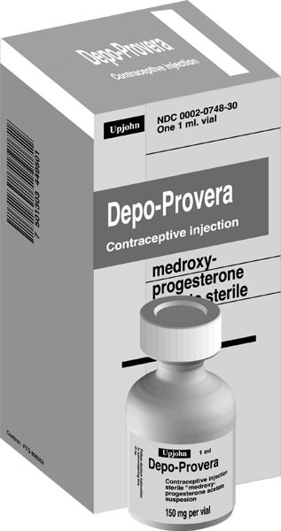
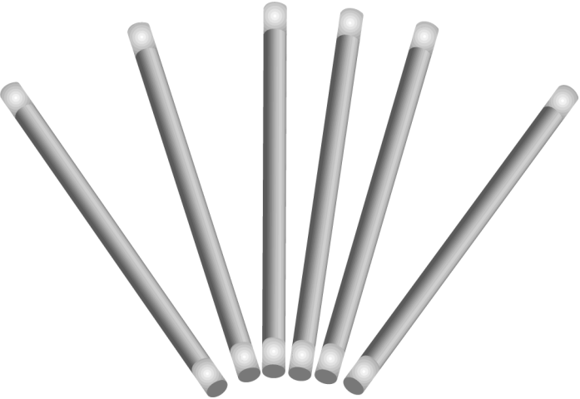
Hormonal contraceptions
B- Long acting steroid contraceptives

Slide 40
Injectable long acting steroids
Medroxy progesterone acetate (Depo Provara)
Administered IM.
Dose 150 mg/ 3 mon.s.
1st injection within 3 days of mensis.
Failure rate 0.1/ HWY.
Doesn’t inhibit lactation.
Common side effects: irregular vag bleeding, amenorrhoea & delayed ovulation for 18 months.
Benefits: independent of coitus, protect against sickler crises, treating endometriosis & prevent endometrial hyperplasia.

Slide 41
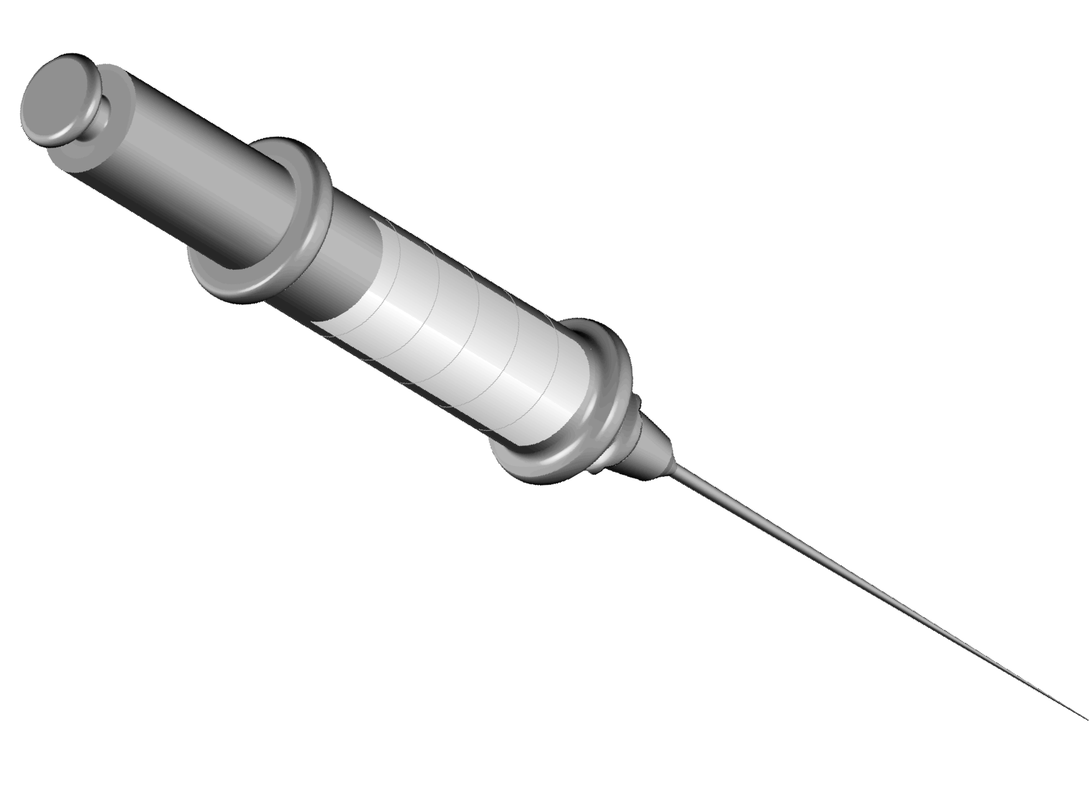
Injectable long acting steroids
Northisterone Enanthate
Given in a dose of 200mg /2 months.

Slide 42
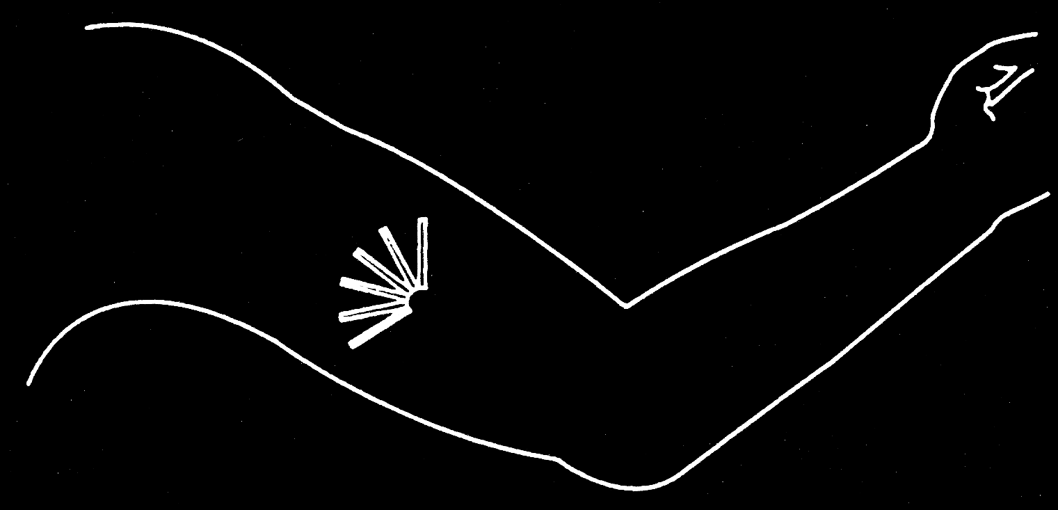
Contraceptive Implant
Norplant
Consist of 6 capsules which are inserted under the skin.
Contain Levonorgestrel.
Used for 5 years.
Failure rate 0.5/HWY.

Slide 43
Postcoital contraception
The morning after pills:
2 tablets (50 microgms ethinyl estradiol & 250 microgm Levonorgestrel) should be taken within 72 Hr of exposure & repeated after 12 Hr.
Copper IUCD used within 48 Hr.
Mifepristone single dose 600 mg.

Slide 44
Sterilization
Is a procedure which destroys the procreative function & the effect is permanent.
Indications:
Permanent ill health of the partner.
Diseases & genetic faults transmissible to the fetus.
Previous obstetric complications eg. Repeated CS.
Family limitation.
On request.

Slide 45
Female sterilization

